Slide 1
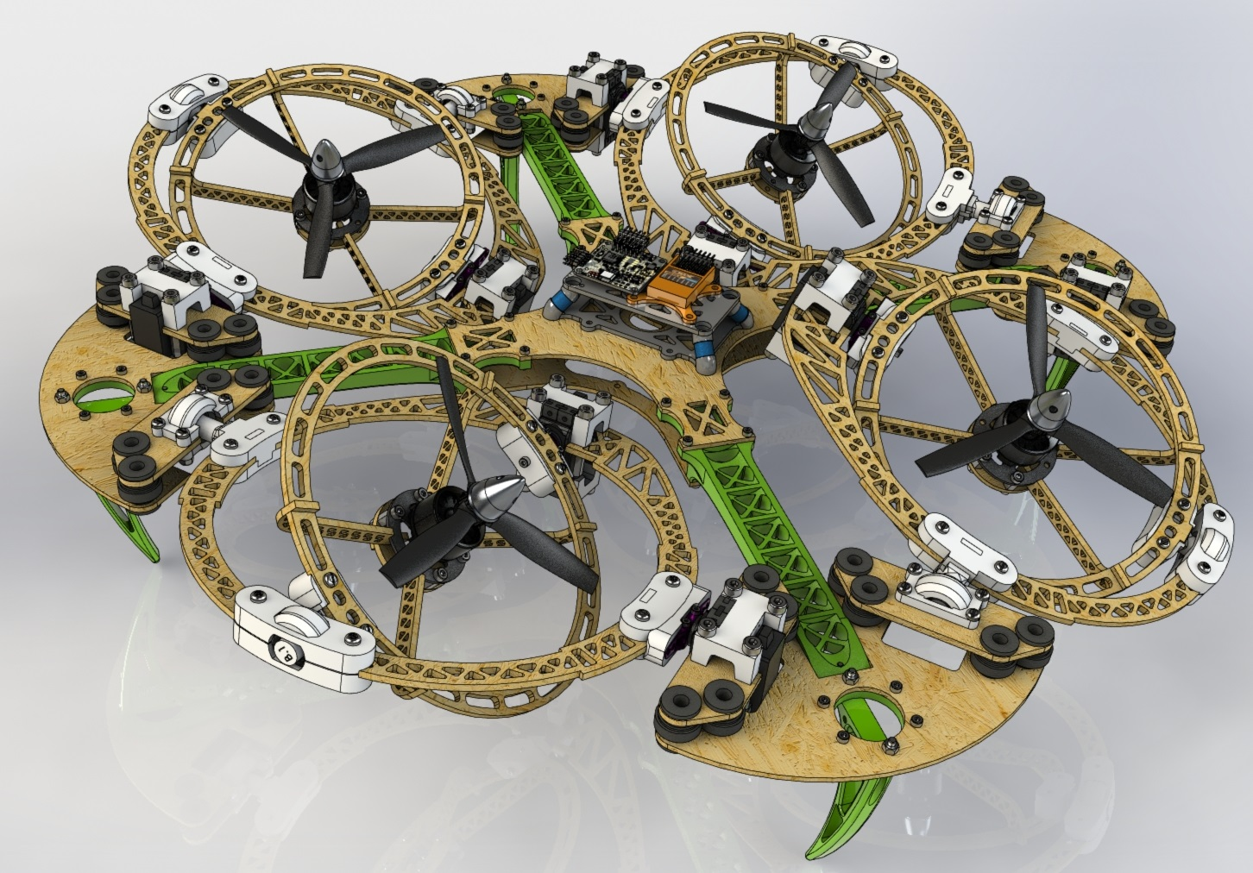

Coppelia Scene: Omnidirectional MultiRotor UAV
By,
Akshay Dhonthi Ramesh Babu - 1887502
Fabian Humberto Fonseca Aponte - 1886565
David Esteban Imbajoa Ruiz - 1922212
Academic Year 2019 − 2020

Slide 2
Introduction
Continuous search for improvement in terms of autonomy and flexibility for air vehicles. The trend continued in unmanned vehicles.
The history of this line of research has branched out into many fields, from which terms like Fully Actuated Drones - FAD and Over Actuated Drones - OAD take an important part of this project.
Each branch has its own difficulties in terms of location, mapping and control theory with respect to its parameters and characteristics.
There is great interest in simulation environments that test the performance of solutions without putting investment capital at risk.

Slide 3
Problem Statement
Build a virtual scene in CoppelliaSim for the design, implementation and evaluation of position and attitude control alternatives over an omnidirectional UAV

Slide 4
Objective
The presentation will cover the following section of the project:
Problem Statement: The purpose of the project.
Methodology: Methods and algorithms for the control proposed.
Implementation: UAV Model design and integration to CoppeliaSim.
Experiments and results: Proposed experiments and associated results.
Conclusion: Milestones achieved at the end of the project.

Slide 5
Basic Knowledge - Concepts
Atomic actuation units (AAU) characterization
Properties
Aerodynamic coefficients
Related to propellers.
(Uni/bi)-directional thrust
The motors rotates in both directions or only one.
Fixed/actuated propulsion shafts
Rigid body or actuated joints wrt propellers frame.
Propellers positions
Spatial location.
Hover Ability
Keeps a constant configuration ( position and orientation).
Trajectory tracking Ability
Tracks position and orientation in the reference space.
Physical Interaction Ability
Interacts with environment through changing forces.

Slide 6
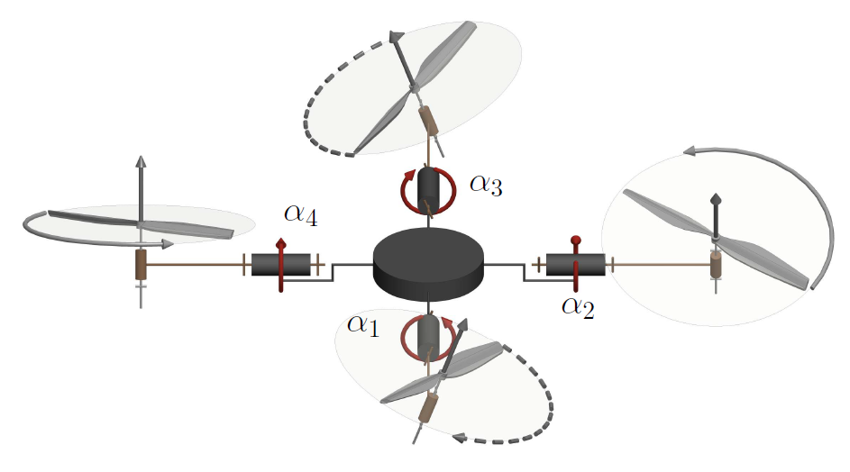
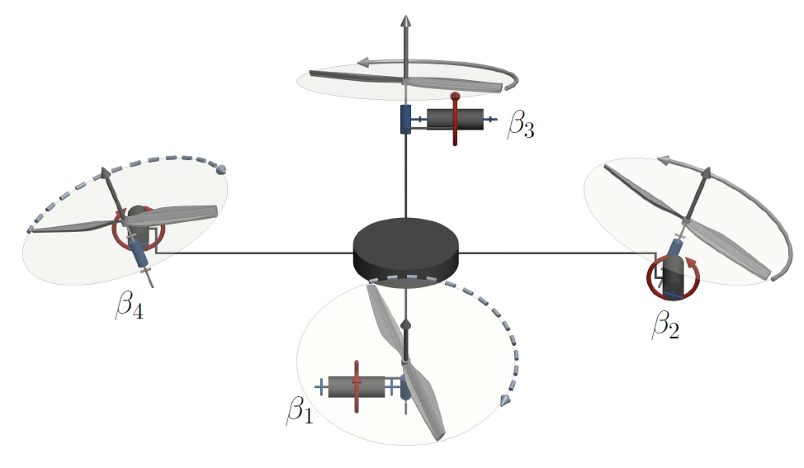
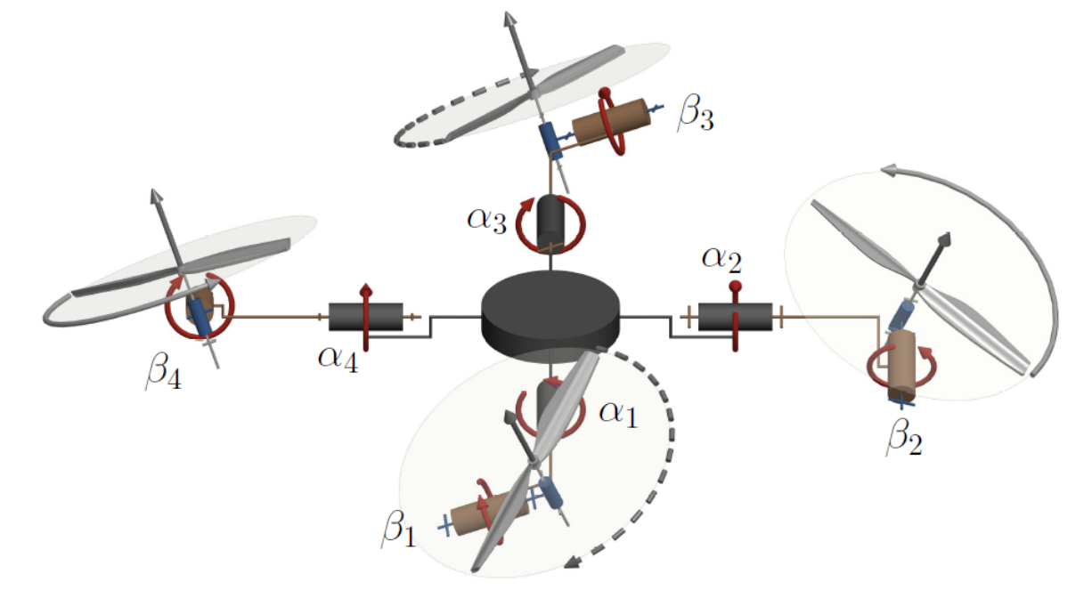
Basic Knowledge-Model
Radial Tilt Design
Tangential Tilt Design
Mixed Tilt Design
Control Model
CAD Model
All the designs are Over-actuated OA, but the control model can be modified to be Fully-actuated FA

Slide 7
Basic Knowledge - Assumptions and Properties
Constant center of mass CoM.
The CoM is not affected by physical components.
Constant aerodynamic coefficients.
Mirroring the orientation of opposing propellers.
Unidirectional thrust.
Constant propellers position.
Actuated propellers, 2 DoF (CAD Design) and 1 DoF (Control Design).
Radial Tilt Design to control

Slide 8
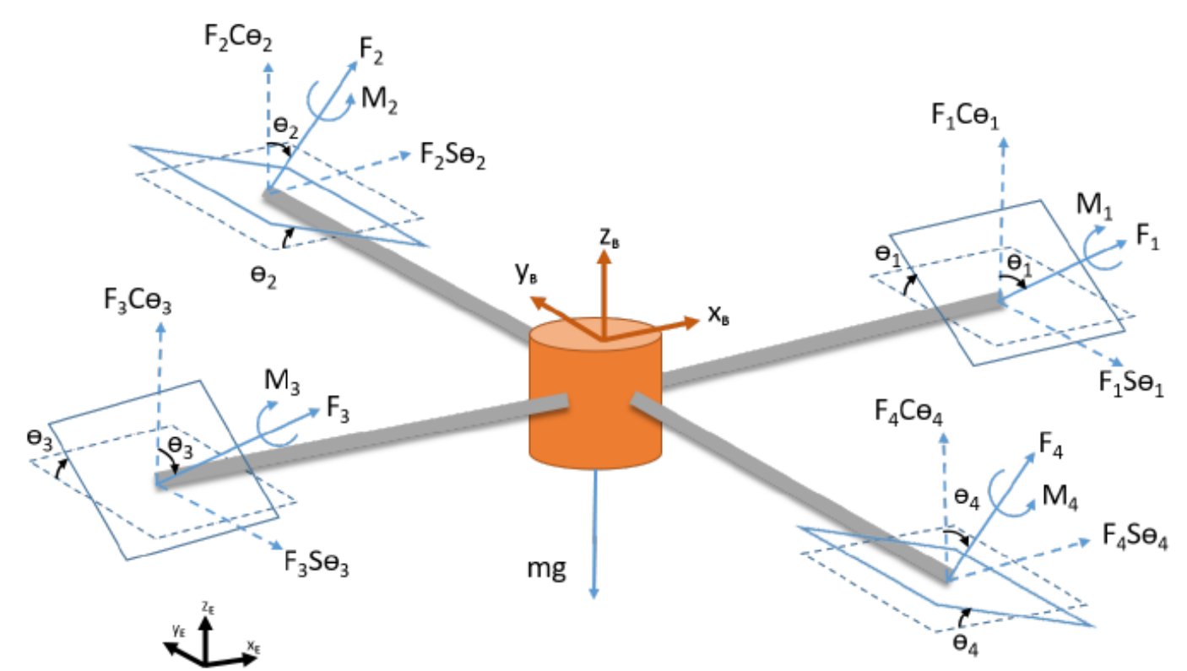
Basic Knowledge-Kinematic Model
One coordinate axes for the base of the drone.
One coordinate axes assigned for each propellant repeated in its counterparts.
One coordinate axes for the environment.
Considerations:
Control simplification by setting θ1 = θ3 and θ2 = θ4.
Total of 6 control inputs: 4 angular velocities. 2 angular positions.
Kinematic model for an UAV with radial tilting

Slide 9
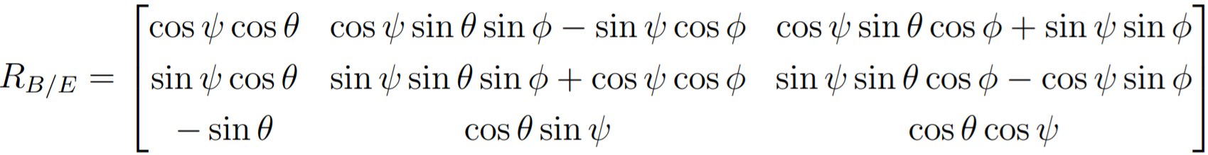
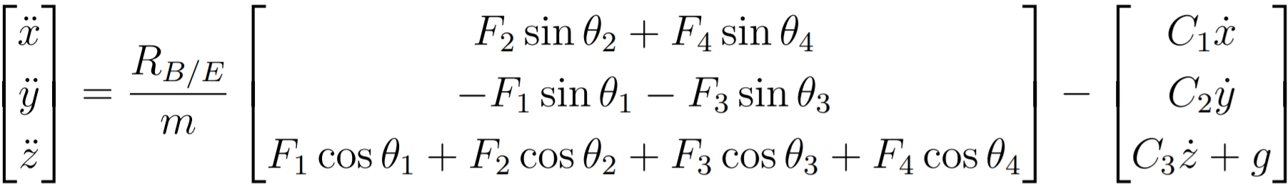
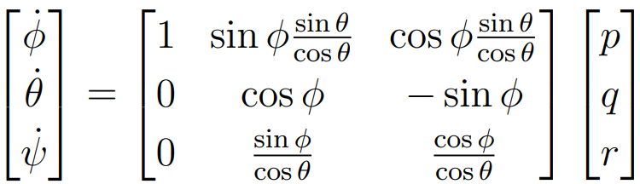
Basic Knowledge-Kinematic and Dynamic Model
Rotation matrix to modify the direction of the generated impulse for each propeller.
Acceleration wrt global reference frame, where, C is the drag coefficient and F is the propellers force.
Global rate of change of orientation wrt body frame, where 𝜽, 𝝓, 𝟁 represents roll, pitch and yaw respectively and p, q ,r are the rates of 𝜽, 𝝓, 𝟁.

Slide 10
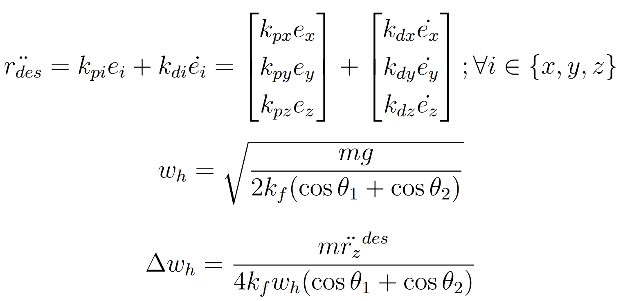
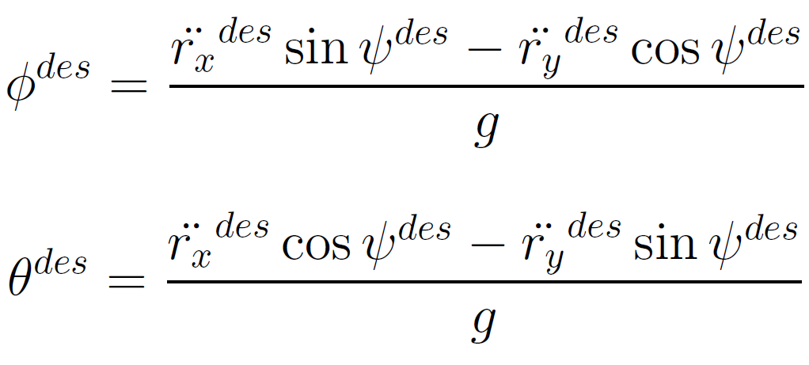
Methodology - PD Position ＆ attitude control
The desired acceleration is given by proportional (Kp) and derivative (Kd) gains, given the error calculations of the desired references.
The desired orientation, in Euler angles, for a given acceleration and a given 𝜓 desired.

Slide 11
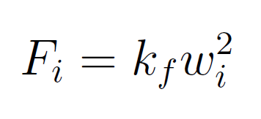
Methodology - PD Position ＆ attitude control
The angular velocity and its rate of change required for hovering is given by 𝜔h and 𝚫𝜔h
where, kf is a constant from the motor forces.
Associated forces produced by each propeller given a constant kf.

Slide 12
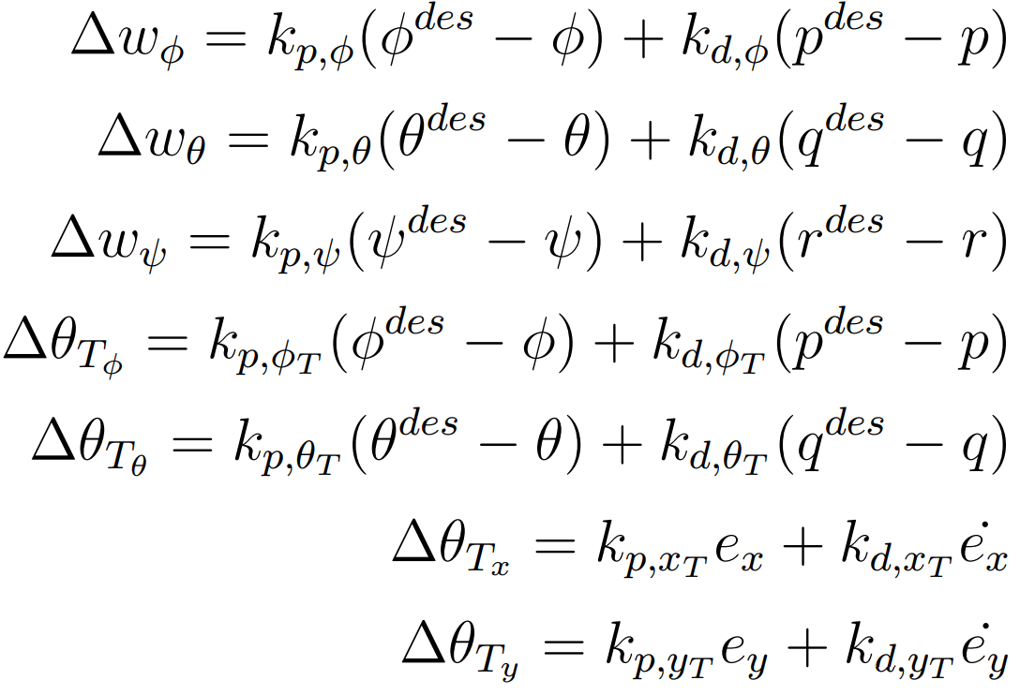
Methodology - PD Position ＆ attitude control
𝚫𝜔 represents the change of angular velocity needed for the rotors to achieve the desired orientation of the UAV.
𝚫𝜽 represents the change in pitch needed for the rotors to achieve the pose (position and orientation).

Slide 13
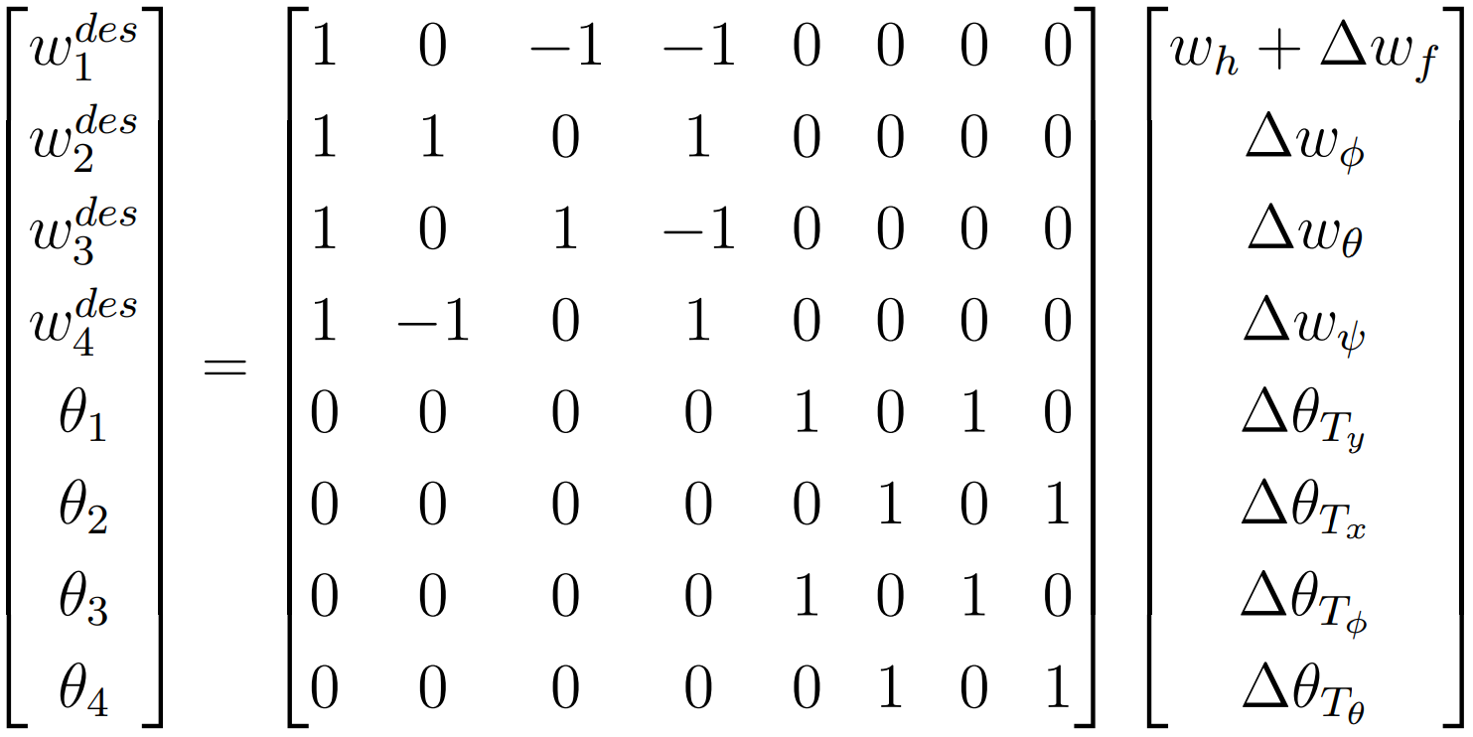
Methodology - PD Position ＆ attitude control
Final representation for the control inputs as linear combination of angular velocities (𝜔) and tilt angles (𝜽).
Linearly dep.

Slide 14
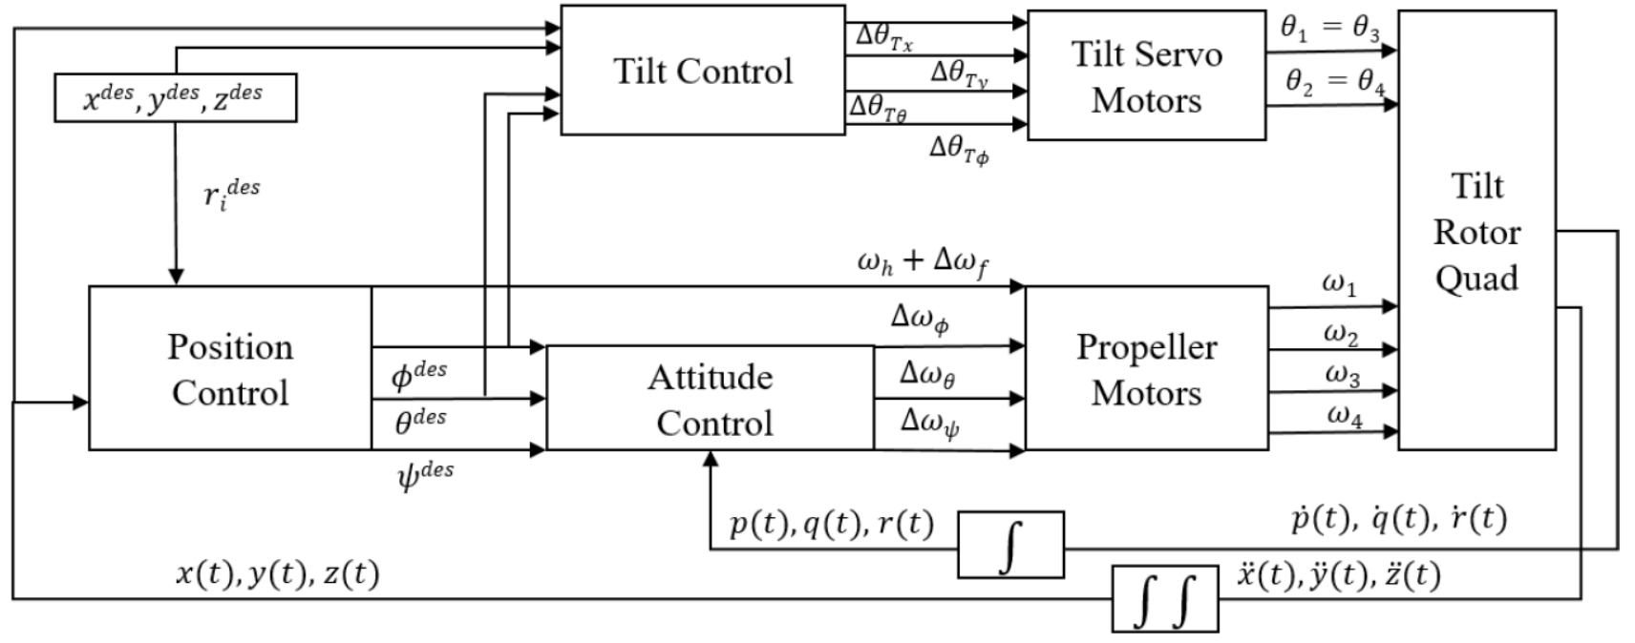
Methodology - Position/attitude control
Control Architecture of Tilting-Rotor quadrotor
The desired PD controller synchronizes the actions taken on the angular velocities and the inclination of the rotors.

Slide 15
Implementation
CAD Model Development
Quadrotor design with 3 dofs in each propeller.
Radial and tangential movements for each propeller.
Integrating model into CoppeliaSim
Grouping and materials.
Shapes development.
Joints and parent-child structure.
Lua Script development.
Tuning gains and Iterative Experimentation
Experimentation route.
Fine tuning for PD gains.

Slide 16

Implementation - CAD Model Development
The quadrotor with propellers tilting in s (radial and tangential).
Over-actuated system.
The tilt angles controlled by servo motors.
Servo motors fast enough to ignore the control loop.
2
The preliminary model is obtained from GRABCAD Community

Slide 17
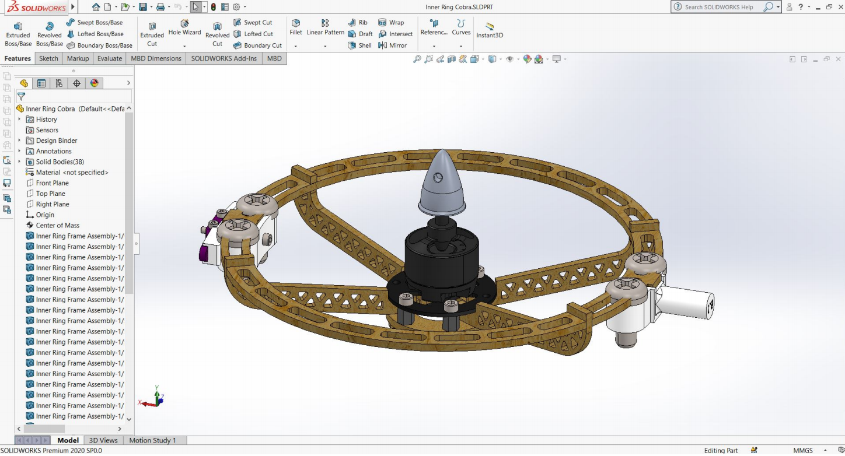
Implementation - CAD Model Development
Designed parts in “SLDPRT” format and assembled.
Propellers axis facing upward to obtain the proper coordinate frame.
Body’s Z-axis faces upward to maintain CoppeliaSim standards.
Single propeller assembled in SolidWorks

Slide 18
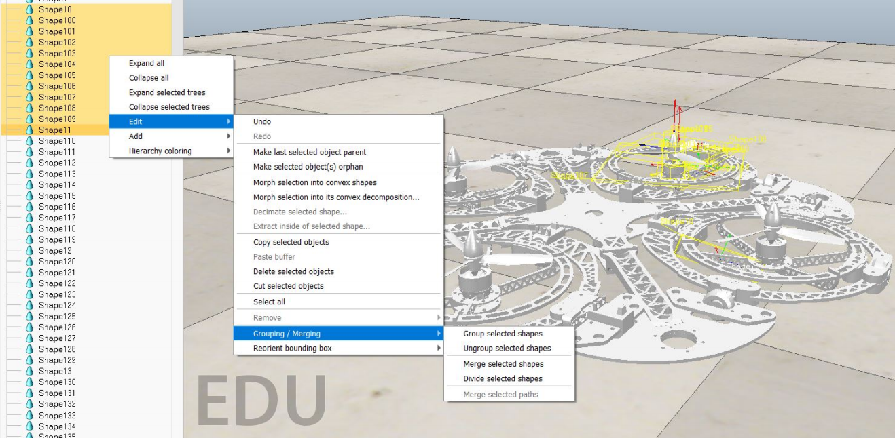
Implementation - Integration into CoppeliaSim
STL files generated by SolidWorks is exported to CoppeliaSim and grouped with their respective fixed parts.
Finally obtain a total of 13 multishape non - pure objects (1 body, 4 propellers, 4 radial rings and 4 tangential rings).
Grouping of multiple non-pure shapes on CoppeliaSim

Slide 19
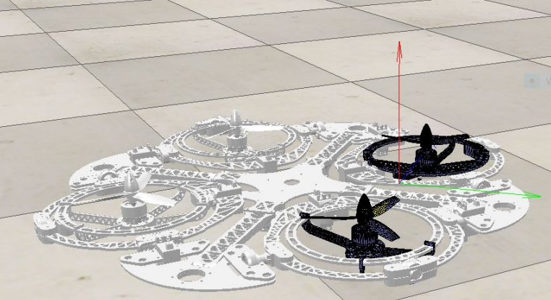
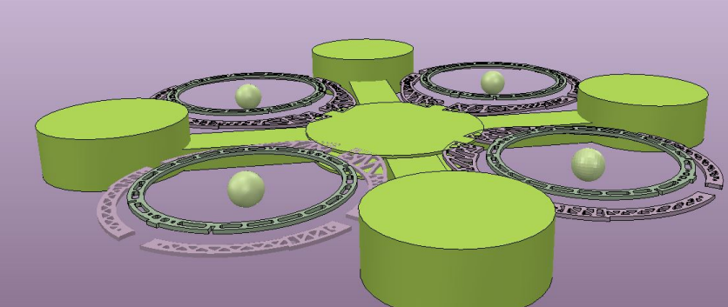
Implementation - Integration into CoppeliaSim
Triangle edit mode available in Coppelia Sim
Model is converted to pure shapes.
Done using triangle edit mode.
Reduces total number of meshes.
Results in smoother dynamic simulation.
Guaranties immediate and smooth response as the shapes are stable.
Final hidden layer with all pure shapes

Slide 20
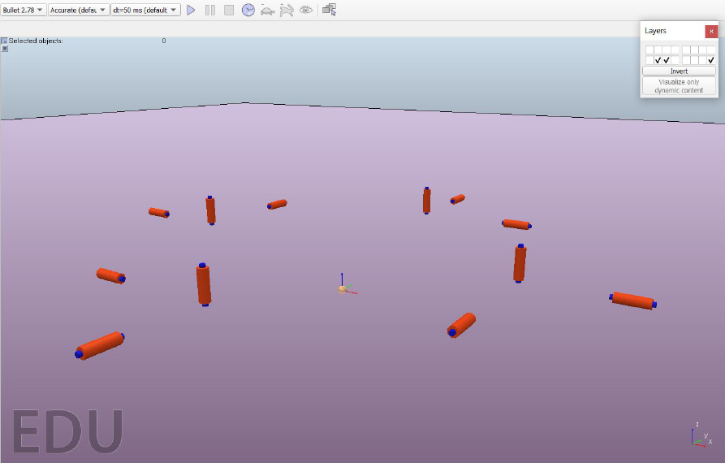
Implementation - Integration into CoppeliaSim
Joint objects generated to assign the type of motion (revolute, prismatic or spherical).
The exact position of each joint obtained by extracting pure triangles shapes from physical joint shafts.
Joints in space for UAV model design

Slide 21
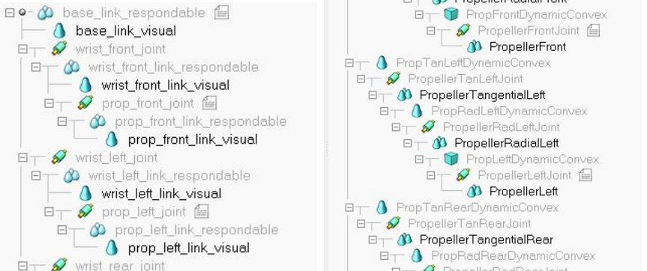
Implementation - Integration into CoppeliaSim
The structure has pure shape then non pure shape and then the joint respectively for all DoFs.
Revolute joints are added to their respective tangential tilt rings as shown in hierarchy structure.
Hierarchy for Radial tilt and non pure part
Hierarchy for Radial and tangential tilt with pure part

Slide 22
Implementation - Integration into CoppeliaSim
Lua script development
Tuning gains-Iterative experimentation
The force and torque are calculated and sent to the skeleton of the UAV.
The propellers are rotated with fixed speed, just for visualisation.
The correct tilt angles can be visualised.
All the functions are programed on non-thread child script.
There are around 20 gains which are tuned to perform smooth attitude control.
Each control input gain is tuned individually by setting the others to zeros.
Forces applied on Z-axis are set by moving the reference frame on the robot by transforming the ground and the robot frame.

Slide 23
Experimentation - Expected Results
Model DOF
Movement visualization and assembly on SolidWorks to understand the degrees of freedom
The propeller and tilt angles are tested on the CoppeliaSim scene to confirm proper placement of rotation joints.
Importing to CoppeliaSim
Simple Quad Attitude control
Initial simulation result with simple attitude control without tilt angles
Attitude control with radial tilt angles
Final Attitude control with radial tilt angles to reach desired position and orientation.

Slide 24
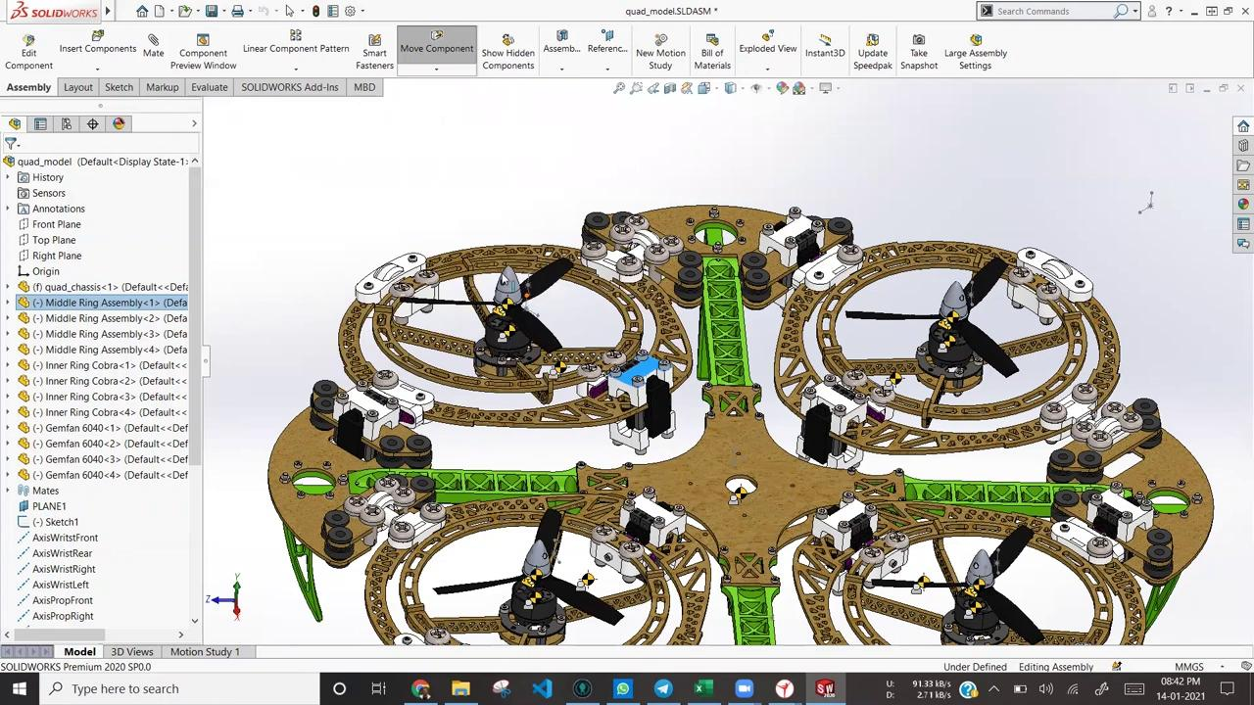
Experimentation
Model DOF

Slide 25
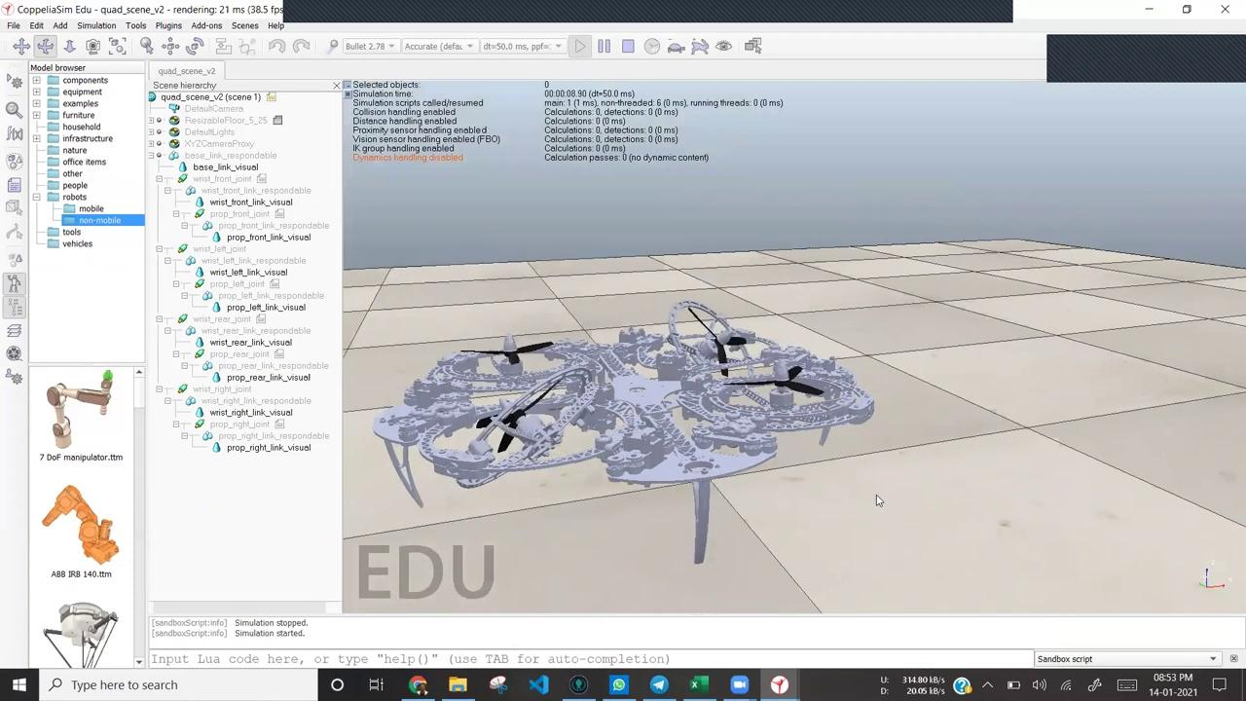
Experimentation
Importing to CoppeliaSim

Slide 26
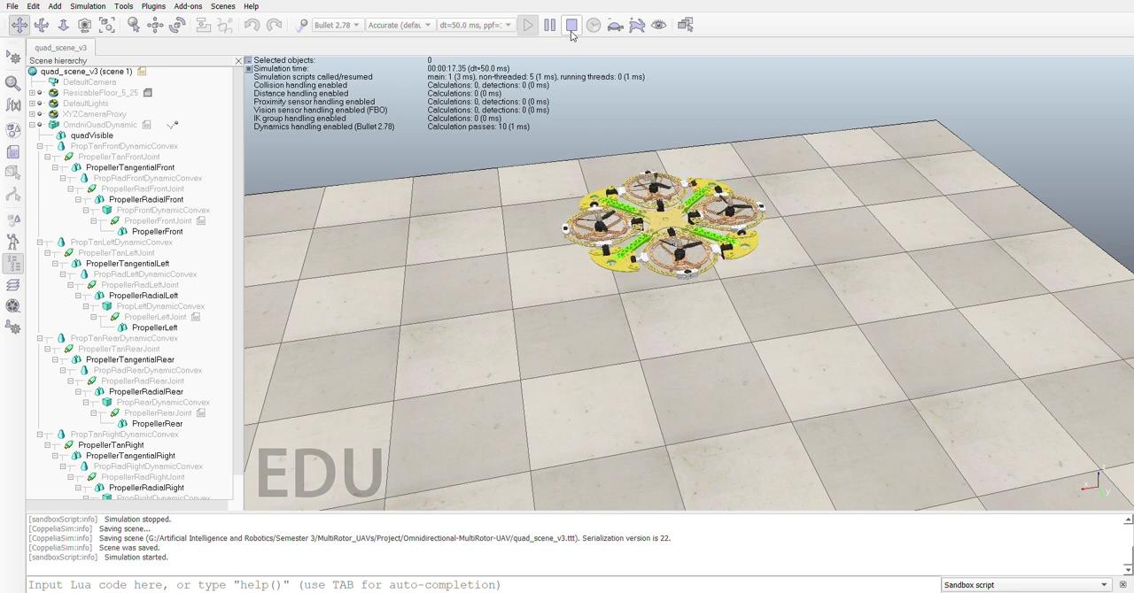
Experimentation
Simple Quad Attitude control

Slide 27
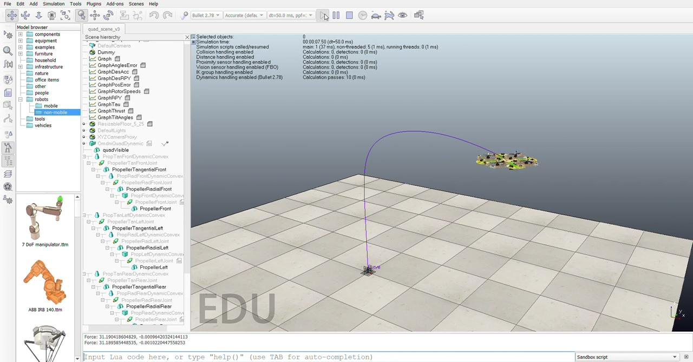
Experimentation
Attitude control with radial tilt angles

Slide 28
Conclusion
A scene was successfully developed in CoppeliaSim with an omnidirectional UAV with 2 additional DoF in each of its propeller.
The integration of a LUA script with the mechanics of the drone was achieved to control its movement in the simulated environment.
A fully actuated control was implemented on the system by enabling only the radial tilt in the propellers and simplifying the model to a 6 inputs control scheme.
The tuning of the gains was achieved presenting an acceptable behavior.
The scene, the model and the code will serve as the basis for future projects and developments compatible with the taxonomy of this work.

